Slide 1

Detection of Exoplanets
Team Name : MAYDAY
Mansi Anil Patil (18137)
Amisha Srivastava (18340)
Yash Agrawal (18410)

Slide 2
Motivation
Does life exist outside Earth? Will humans be able to reach there anytime soon in the future? To find solutions to these problems, we have to solve a subproblem first.
We need to find planets in outer space. Once we find a new world, we need to do further research to check if it is habitable.
Undoubtedly, searching the existence of life on a new planet is itself an enormous and tedious task. But for now, we limit ourselves to the problem of finding new planets in deep space, also known as Exoplanets.
These planets can benefit us greatly if they are habitable
Thus our topic revolves around detecting these exoplanets which can then further be analyzed to search for signs of life.

Slide 3
Research Gap
Various publications using deep learning techniques have been deployed in the proposed field and numerous solutions have been found.
Our project differs from these existing research works in the way, that we have applied basic and simple AI techniques to these datasets in order to ease the complexity and try to reduce the runtime for this problem.
We have further compared the performance of different ML techniques with deep learning methods (neural networks).

Slide 4
Objective
The main objective of this project is to Detect the exoplanet revolving around a set of stars given in the dataset in order to ease up the detection of habitable planets using a suitable planet detection method.
We have applied different AI techniques and analysed what algorithm is best suited for the prediction of the existence of an exoplanet in the vicinity of the star in question.
The test data labels are accurately predicted after comparing the performance of these algorithms using evaluation metrics
In this way, AI can be used for exoplanet detection to avoid human error.

Slide 5
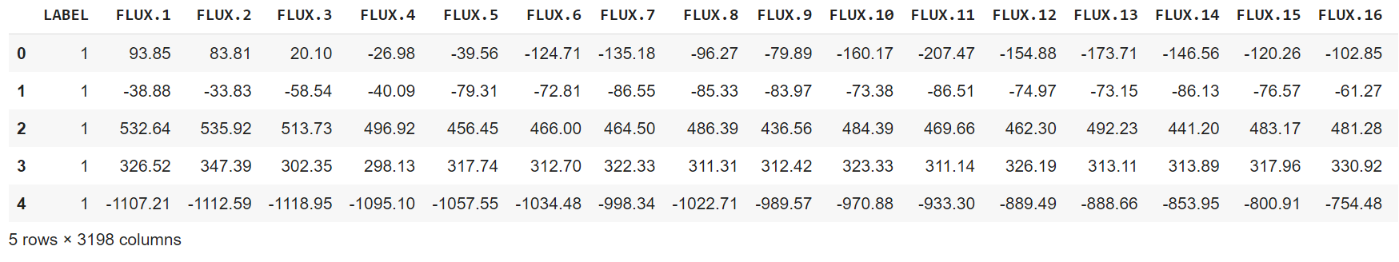
Methodology
Data Preprocessing:
The dataset we used consists of the change in flux(light intensity) of several thousand stars obtained by transit method. Each star has a binary label 1 and 2. The label 2 indicates that the star is confirmed to have at least one exoplanet in orbit.
One metric that we used is "Recall Score".So Recall is the metric which lies between 0 to 1. And that will be maximum(1) if there are all points which belongs to positive class and also predicted as positive points and will be minimum(0) if there are all points which belongs to positive class but predicted as negative points. Therefore we changed our labels from 2 to 1 and 1 to 0.
The dataset before preprocessing :
Notes:
It turns out that the data is highly imbalanced. So first let us start with data preprocessing techniques. let's plot the actual data points from both positive and negative class. To understand the little_bit of behaviour of points from both class.

Slide 6
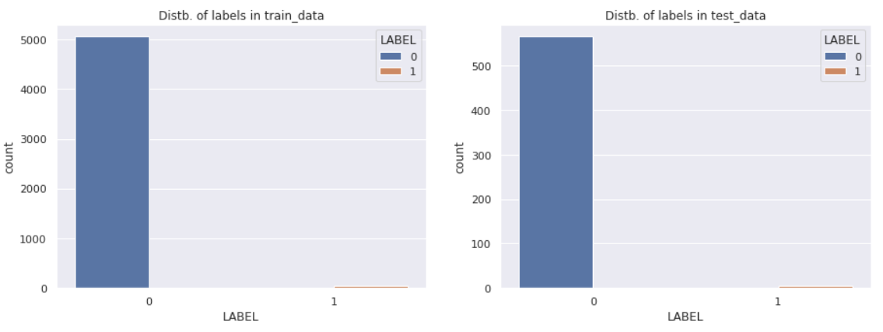
Visualizing the target column in the training and testing dataset.It turns out that the data is highly imbalanced since there is almost zero count for label ‘1’.
Notes:
In Both train and test dataset we can see more than 99% of datapoints belongs to negative class(class_1). And less than 1% of data points belongs to possitive class(class_2).It simply means we have more than 99% of datapoints. which doesn't ends up being decliared as a Exoplanet. Hence only less than 1% of observations are real Exoplanets.

Slide 7
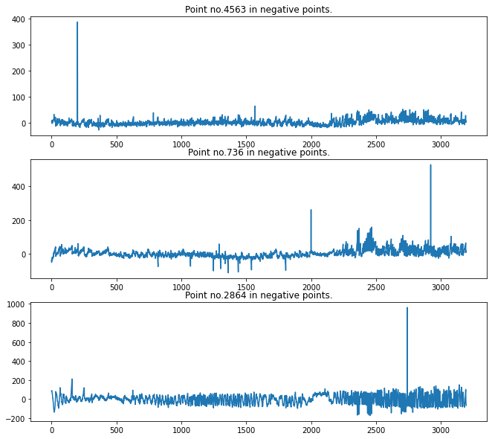
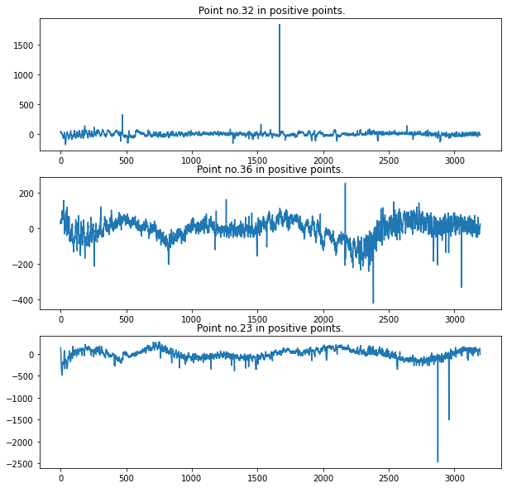
PLotting of any 3 random points from both classes for Visualization
Plotting points from negative class
Plotting points from positive class
Notes:
The range of flux values is not ranging much. It means the the intensity of light we are getting from any star is not ranging much. Hence there should not be any exoplantes. Since these plots are of negative data points(those points which doesn't contain a exoplanet). Then it makes sense. Just opposite from negative points here in all above 3 plots the flux values are ranging much with a pattern. It means that the light intensity values coming from star is varrying much. They simply goes down and then again comes up. Hence there should be an exoplanet which is orbitting the star. When that exoplanet orbits in front of star then the intensity value of light goes down. And when after some time that star reaches behind the star then intensity values of light again comes up.

Slide 8
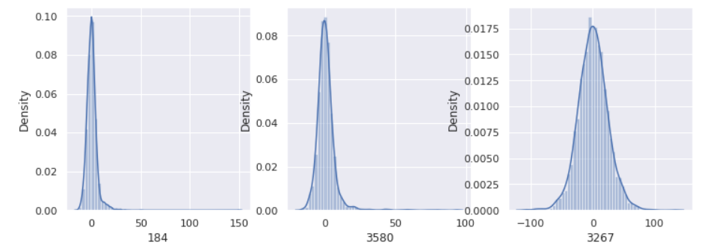
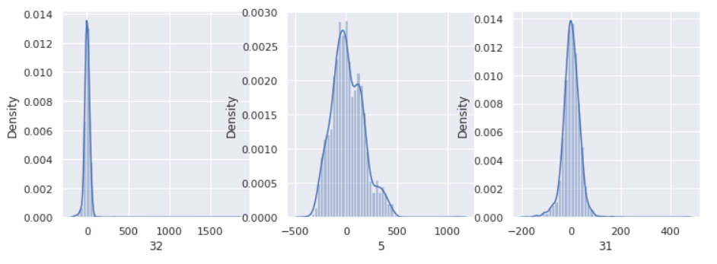
Probability Distribution functions of points from negative class
Probability Distribution functions of points from positive class
Notes:
in negative class points the values of flux are coming from a small range as comparted to positive class. It means intensity values of light coming from any star is almost same. Hence there shoud not be any exoplanet. in positive datapoints we can see the flux values are coming from a wide range as compared to negative points. it means light intansity values comingb from any star is diming and again coming up. Hence there is a exoplanet orbiting the star. thats why because of exoplanet the light intensity again comes up and goes down.

Slide 9
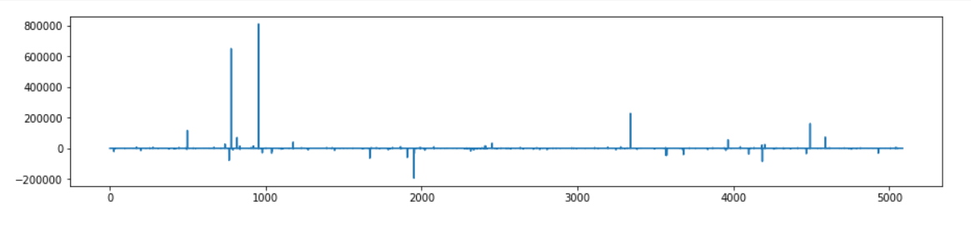
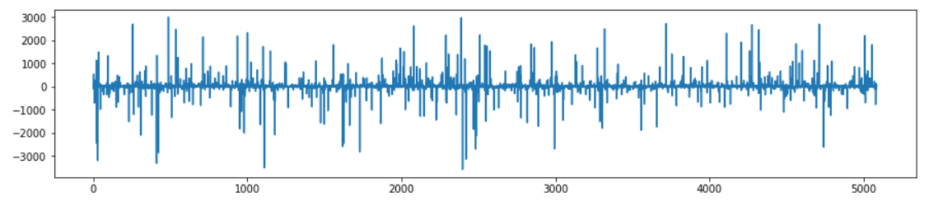
Detecting and removing Outliers
The above figure indicates a random flux value from the training set and it can be seen it is influenced by outliers.
The above figure now shows the same flux value after removal of outliers.
Notes:
As we can clearly see now there is not any very high alone line. It means there is not any point which doesn't lies in the range of rest all values. For being much sure lets again print percentiles .

Slide 10
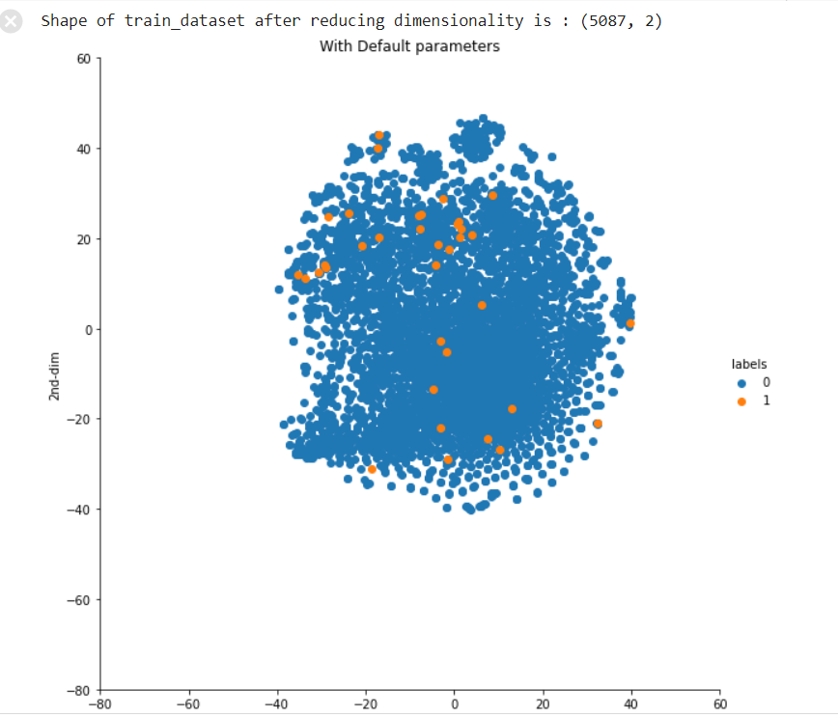
The Training data is more than 3k dimensional. To visualize it, we need to reduce its dimensionality to 2 or 3 dimensions. This is done using T distributed-Stochastic Neighborhoods Embeddings (TSNE).
The plot shown here is the training data after applying TSNE.
The positive points are clearly overlapping with negative classes points here.
Notes:
The positive points are clearly overlapping with negative classes points. This implies Its going hard to make a model which can separate points of both classes. Again , It could be possible because we are going from 3k dimensions to just 2 dimensions. But lets not worry much and go for modeling Because models are the last truth. We can not make any slid conclusion just by seeing T-sne plots.

Slide 11
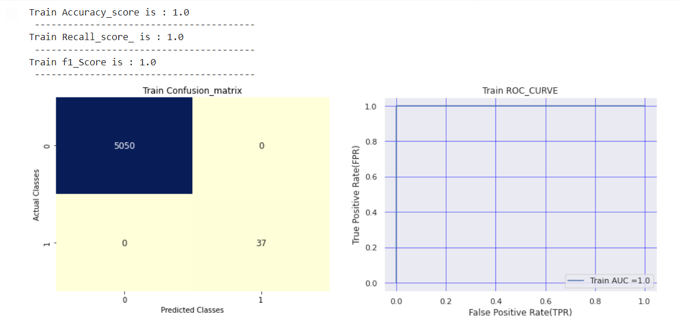
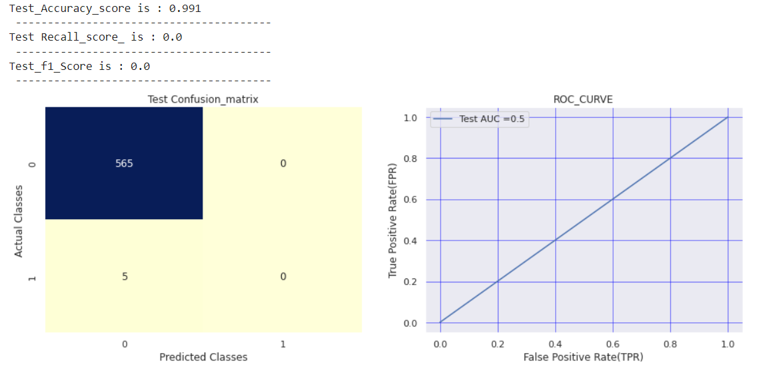
All models (KNN shown in fig) are performing very good on Train data. But bad on Test data.
Also In Test data models are performing good on Negative class points. But bad on positive class points.The main reason for this is the " Imbalance nature of dataset" or in other words "lack of positive class points"
Train score is high and test score is low then we are heading towards overfitting. We saw models are overlearning negative points and not learning much about positive points.

Slide 12
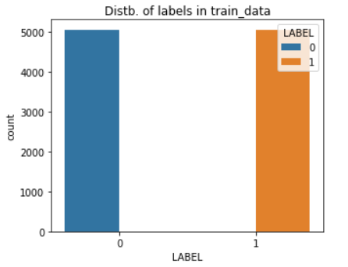
We already have too little data (only 5087 points). Hence we can't afford under sampling here. So we did oversampling.
After oversampling our data is now balanced.

Slide 13
Evaluation metrics
Evaluating a model is a major part of building an effective machine learning model. The most frequent classification evaluation metric that we use should be ‘Accuracy’.However, it is not always true and can be misleading in some situations. So, we used following evaluation metrics for analysing the best classifier :
CONFUSION MATRIX: The matrix compares the actual target values with those predicted by the machine learning model. This gives us a holistic view of how well our classification model is performing and what kinds of errors it is making.
2. The key classification metrics:
Accuracy: It is the fraction of predictions our model got right.
Recall: In a binary classification problem, recall is calculated as the number of true positives divided by the total number of true positives and false negatives.
F-measure : It is the harmonic mean of model’s precision and recall.
3. Receiver Operating Characteristic (ROC) curve : It is a plot of the false positive rate (x-axis) versus the true positive rate (y-axis) for a number of different candidate threshold values between 0.0 and 1.0. Put another way, it plots the false alarm rate versus the hit rate.An operator may plot the ROC curve for the final model and choose a threshold that gives a desirable balance between the false positives and false negatives.
Notes:
Classifiers that give curves closer to the top-left corner indicate a better performance. As a baseline, a random classifier is expected to give points lying along the diagonal (FPR = TPR). The closer the curve comes to the 45-degree diagonal of the ROC space, the less accurate the test.

Slide 14
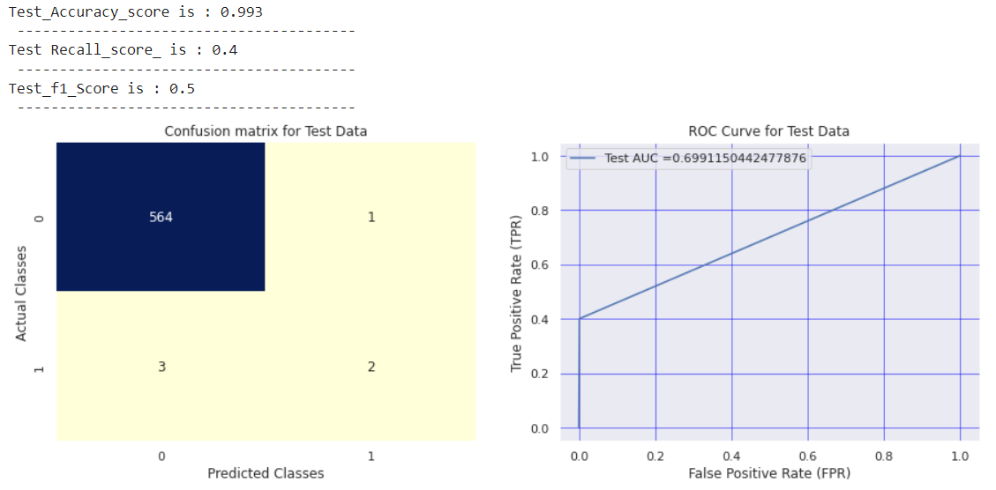
K-nearest neighbour
Notes:
Classifiers that give curves closer to the top-left corner indicate a better performance. As a baseline, a random classifier is expected to give points lying along the diagonal (FPR = TPR). The closer the curve comes to the 45-degree diagonal of the ROC space, the less accurate the test.
A k-nearest-neighbor algorithm, often abbreviated k-nn, is an approach to data classification that estimates how likely a data point is to be a member of one group or the other depending on what group the data points nearest to it are in.

Slide 15
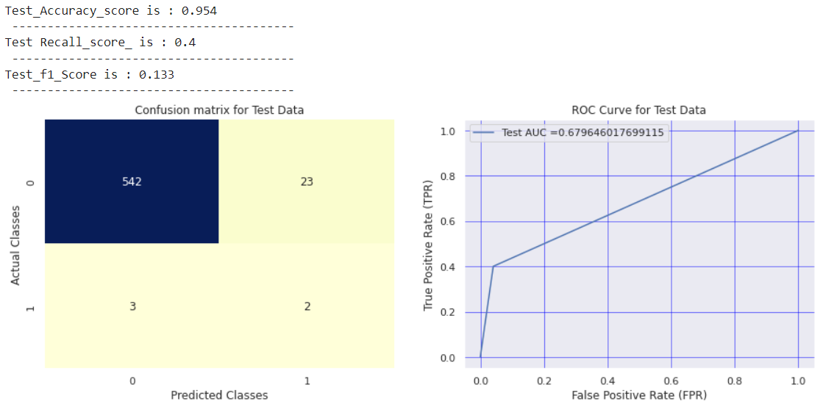
Logistic Regression
Notes:
Logistic regression is a statistical model that in its basic form uses a logistic function to model a binary dependent variable.

Slide 16

Decision tree
Notes:
Decision Tree classifiers use decision trees to make a prediction about the value of a target variable. The decision trees are basically functions that successively determine the class that the input needs to be assigned.

Slide 17

Support Vector Machine
Notes:
A support vector machine (SVM) is machine learning algorithm that analyzes data for classification and regression analysis. SVM is a supervised learning method that looks at data and sorts it into one of two categories.

Slide 18
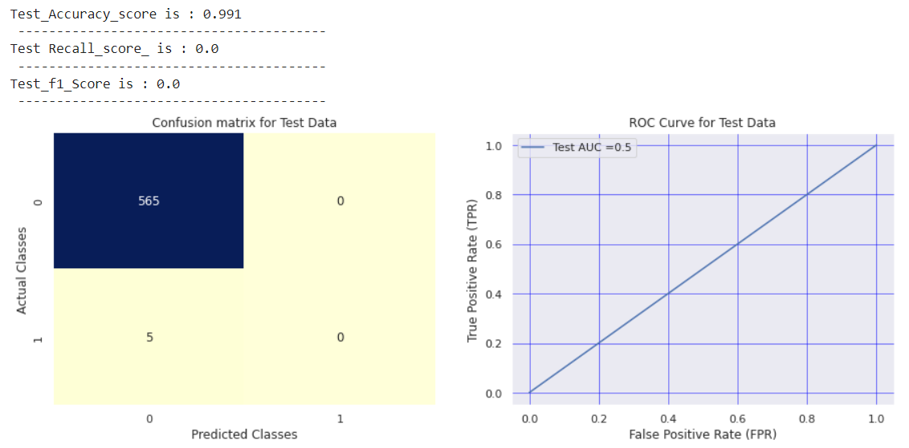
Random Forest
Notes:
Random forests or random decision forests are an ensemble learning method for classification, regression and other tasks that operates by constructing a multitude of decision trees at training time. For classification tasks, the output of the random forest is the class selected by most trees.

Slide 19
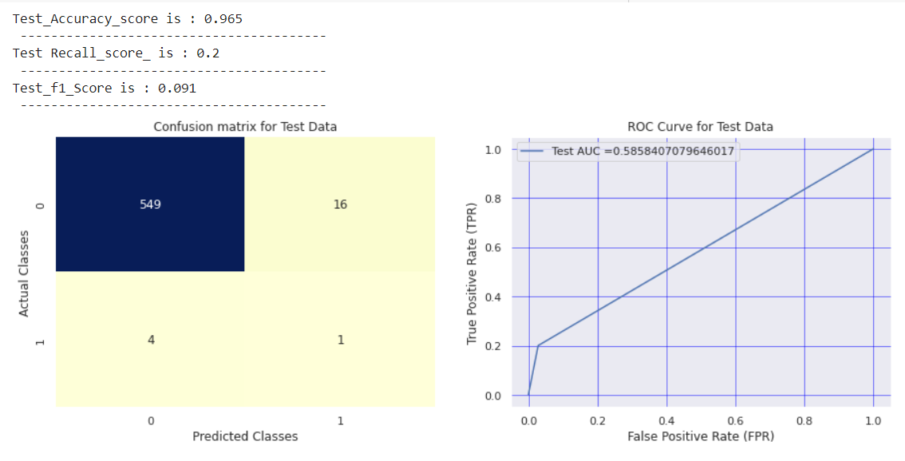
Naive Bayes
Notes:
naive Bayes classifiers are a family of simple "probabilistic classifiers" based on applying Bayes' theorem with strong (naïve) independence assumptions between the features.

Slide 20
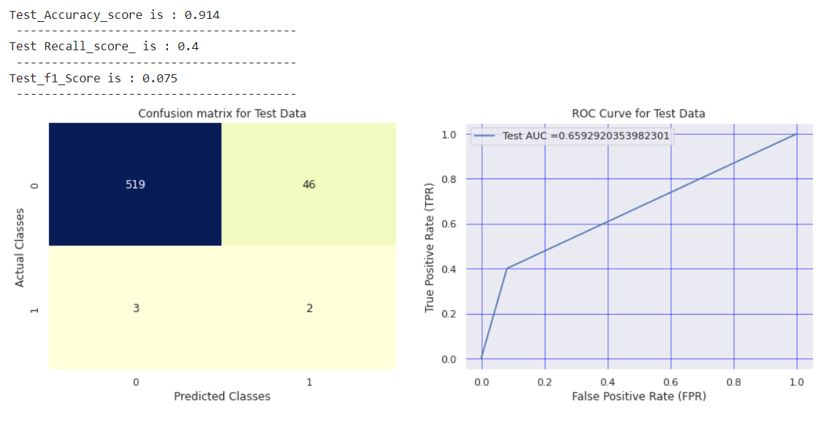
Neural Network
Notes:
Neural Network is a computational learning system that uses a network of functions to understand and translate a data input of one form into a desired output, usually in another form.

Slide 21
Results and Discussions
Using the above models for prediction, we got the following evaluation metrics scores as a means of results :
Method | Accuracy | Recall | F1 Score
Naive Bayes Algorithm | 0.965 | 0.2 | 0.091
Logistic Regression Classification | 0.954 | 0.4 | 0.133
Decision Trees Classifier | 0.977 | 0.4 | 0.235
Random Forest Classifier | 0.991 | 0.0 | 0.0
Support Vector Classifier | 0.979 | 0.2 | 0.143
k-NN Classifier | 0.993 | 0.4 | 0.5
Neural Network Classification | 0.914 | 0.4 | 0.075

Slide 22
As earlier, the data points in the train set were imbalanced as number of positive points in the dataset were much much larger as compared to the negative data points. So, it was absolutely necessary to balance the data for implementation of the models.
The performance of various models improves on the test data if we analyse the comparison of the new models that were trained on balanced data to those trained on imbalance earlier.
Also, we can find a slight improvement in the prediction of positive points in test data for each model except Random Forest. This might be due to the fact that a large number of trees makes the algorithm slower and ineffective for real-time predictions.
The best classification model in our case was for k-NN classifier. When we trained k-NN earlier then the f-measure value on test data was literally 0%. But after oversampling, it improved upto 50%, which in this case is excellent result by the classifier. k-NN is suitable than the rest because of its storing capability on the train data and classifying the test data based on the similarity. This means that as new data emerges, it may be quickly sorted into a suitable category.

Slide 23
Conclusions
As seen from the table it was observed that k-NN classifier had the highest accuracy, highest F1 score and the highest recall among all the classifiers.
The neural network model (ie. deep learning) could not outperform the other classifiers and was the worst performer. Supervised learning methods proved to be more useful and accurate than this deep learning method.
The performance of each classifier observed was in the terms of runtime and accuracy achieved by each depended on the data volume (number of samples and features, our data had around 5k samples) and data quality (outliers, which we removed and imbalance data, which we balanced).
So, in this project we predicted the presence of exoplanets using supervised learning techniques and deep learning.
FUTURE WORKS:
We had only around 5k samples in the training dataset and could not have access to larger dataset of telescopes or space observatories. So, in the future there is scope of improving and applying this deep neural network technique using a larger dataset.
The performance of each classifier in terms of runtime and accuracy will depend on the data volume (number of samples and features) and data quality (outliers, imbalanced data).

Slide 24
Acknowledgments
We would like to express our special thanks of gratitude to our course instructor Dr. Vaibhav Kumar who gave us this golden opportunity to work on this wonderful project. It broadened our horizons in the field of Artificial Intelligence which inspired us to do a lot of research and helped us in gaining a greater understanding of the subject.

